Slide 1
Confidence Interval

Slide 2
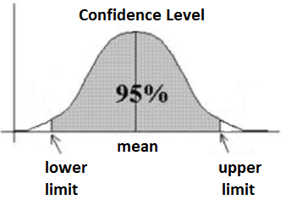
What Is Confidence Interval?
A confidence interval, in statistics, refers to the probability that a population parameter will fall between two set values for a certain proportion of times. Confidence intervals measure the degree of uncertainty or certainty in a sampling method. A confidence interval can take any number of probabilities, with the most common being a 95% or 99% confidence level.

Slide 3
Understanding Confidence Interval
Statisticians use confidence intervals to measure uncertainty. For example, a researcher selects different samples randomly from the same population and computes a confidence interval for each sample. The resulting datasets are all different; some intervals include the true population parameter and others do not.
A confidence interval is a range of values that likely would contain an unknown population parameter. Confidence level refers to the percentage of probability, or certainty, that the confidence interval would contain the true population parameter when you draw a random sample many times. Or, in the vernacular, "We are 99% certain (confidence level) that most of these datasets (confidence intervals) contain the true population parameter."

Slide 4
Calculating a Confidence Interval
Suppose a group of researchers is studying the heights of high school basketball players. The researchers take a random sample from the population and establish a mean height of 74 inches. The mean of 74 inches is a point estimate of the population mean. A point estimate by itself is of limited usefulness because it does not reveal the uncertainty associated with the estimate; you do not have a good sense of how far away this 74-inch sample mean might be from the population mean. What's missing is the degree of uncertainty in this single sample.
Confidence intervals provide more information than point estimates. By establishing a 95% confidence interval using the sample's mean and standard deviation and assuming a normal distribution as represented by the bell curve, the researchers arrive at an upper and lower bound that contains the true mean 95% of the time. Assume the interval is between 72 inches and 76 inches. If the researchers take 100 random samples from the population of high school basketball players as a whole, the mean should fall between 72 and 76 inches in 95 of those samples.

Slide 5
If the researchers want even greater confidence, they can expand the interval to 99% confidence. Doing so invariably creates a broader range, as it makes room for a greater number of sample means. If they establish the 99% confidence interval as being between 70 inches and 78 inches, they can expect 99 of 100 samples evaluated to contain a mean value between these numbers. A 90% confidence level means that we would expect 90% of the interval estimates to include the population parameter. Likewise, a 99% confidence level means that 95% of the intervals would include the parameter.

Slide 6
